Slide 1
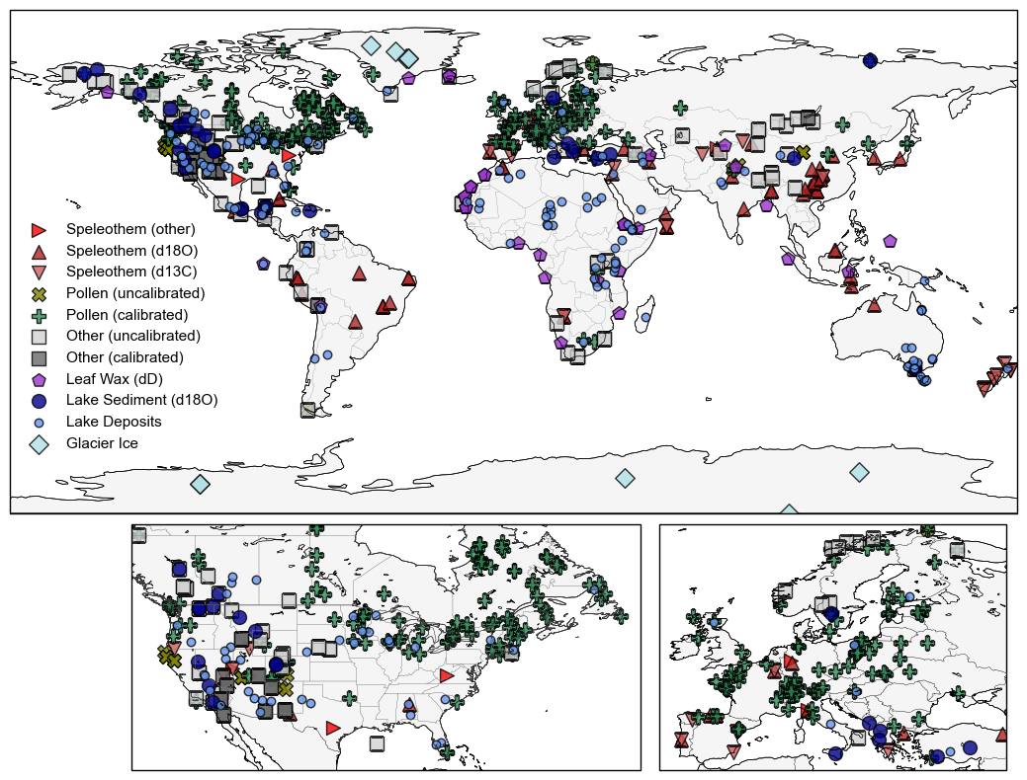
Figure 1: proxies/archives categories
Notes:
Need to talk with cody about revising categories and match symbology with wNA
Add (n=) to legend

Slide 2
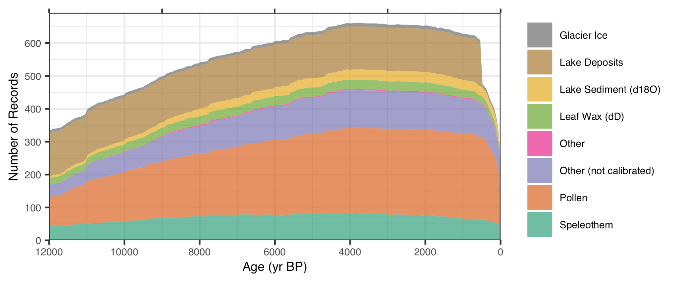
Figure 2: # of records over time
Notes:
Match colors with those on map.
Maybe add (resolution = x-years) tp legend

Slide 3
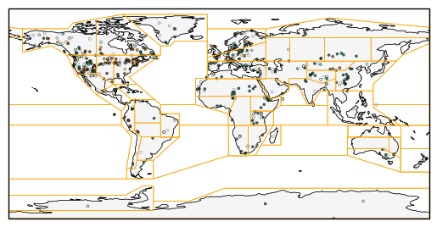
Figure 3: # IPCC regions and Proxy Data
Notes:
(Symbol = 6ka-0ka)
Advantages:
don’t change when adding/removing data
Temperature and Hydroclimate regions can be the same
Script can flow smoothly in python without having to switch to device with ArcGIS pro
2) Less arbitrary / no parameters I select
3) translate to other research

Slide 4
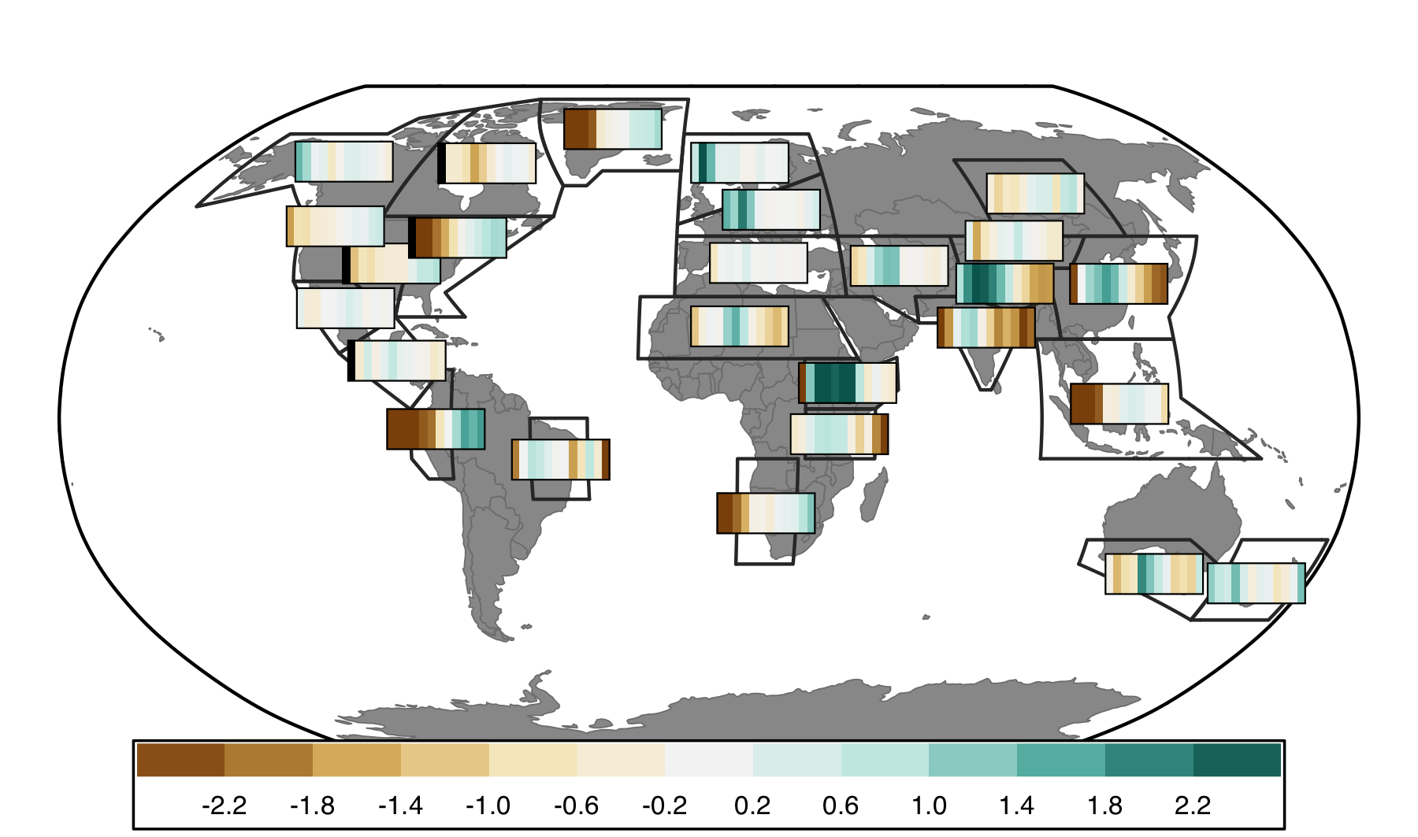

Slide 5
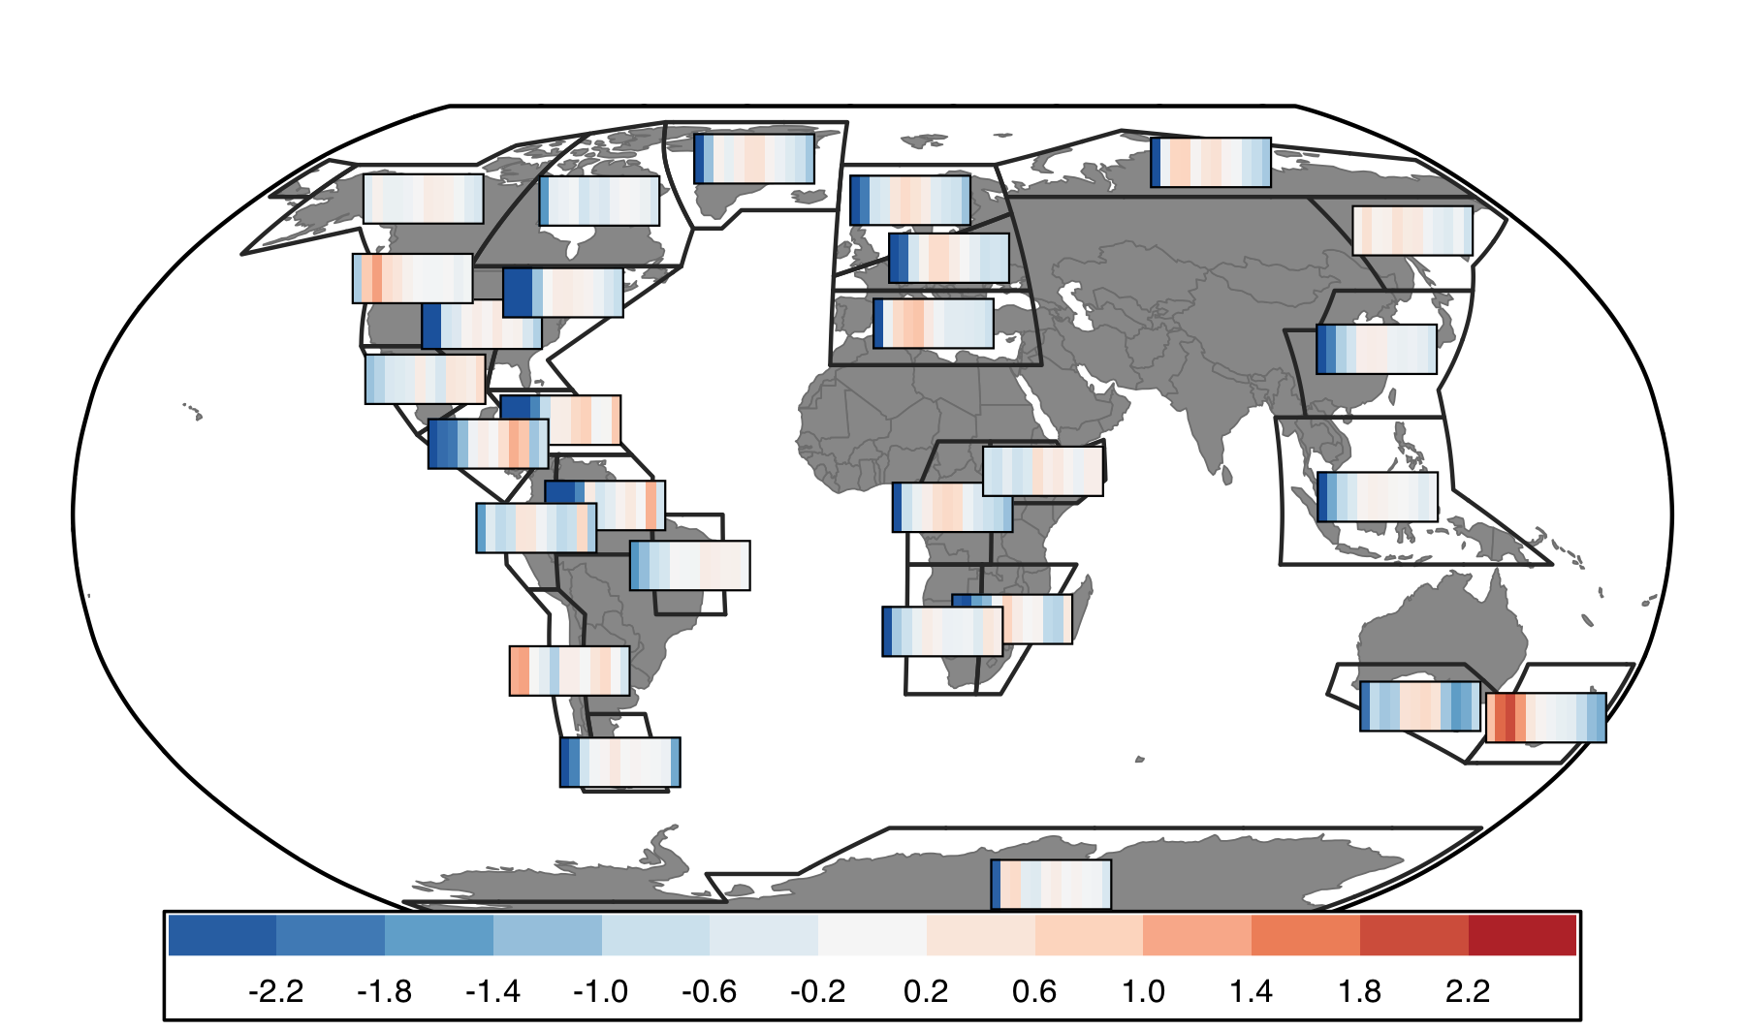

Slide 7
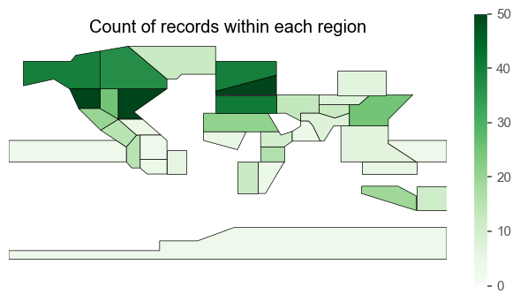
Or could use IPCC

Slide 8
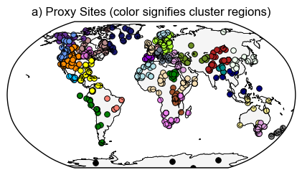
Figure 3: Cluster results
Notes:
R2 values: check from arcgis output

Slide 9
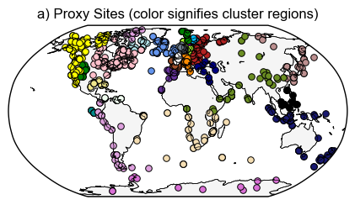
temperature
Notes:
Colors based on HC cluster # so will change to better distinguish neighboring clusters (pacific South America and Antarctica / 2 in Australasia)

Slide 10
Notes:
(Min of 3)

Slide 11
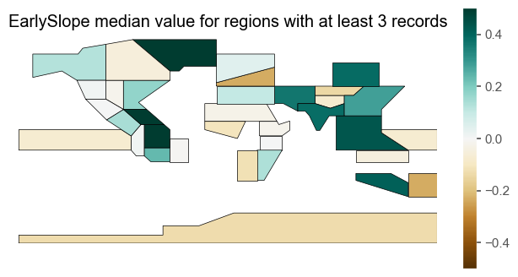
Notes:
(Min of 3)

Slide 12
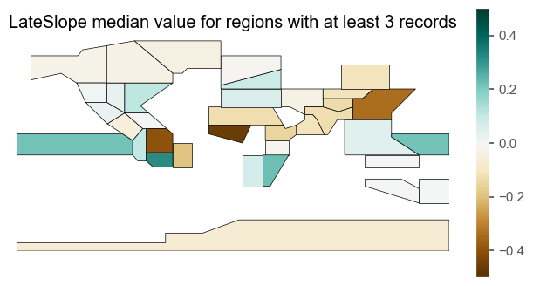
Notes:
(Min of 3)

Slide 13
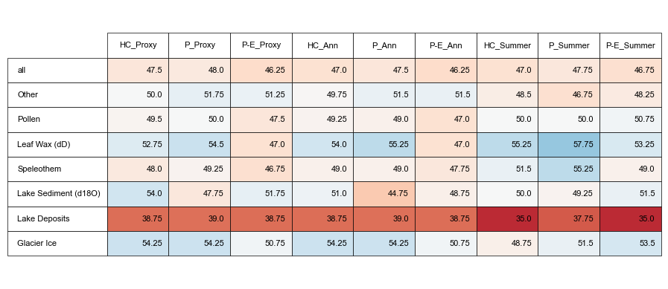
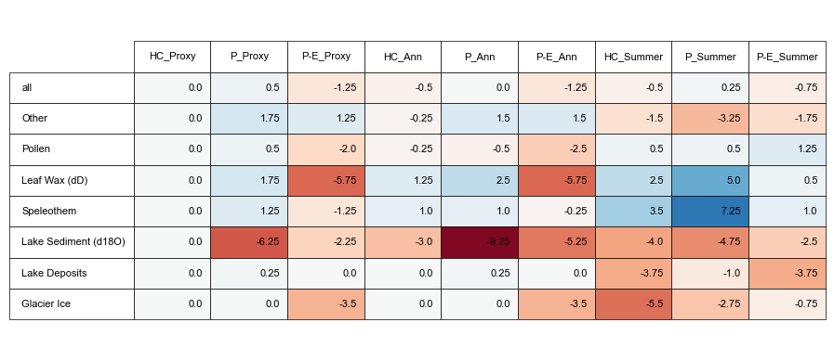
Notes:
Comparisons of how proxies (hydroclimate) compare with model pseudoproxies based on various assumptions about proxy climate interpretation (proxy metadata vs all P vs all P-E) and seasonality (proxy metadata vs assume annual are summer vs assume all are summer)
Top: Absolute %
Bottom: Difference between assumption test and using proxy metadata for both assumptions (1st column)

Slide 14
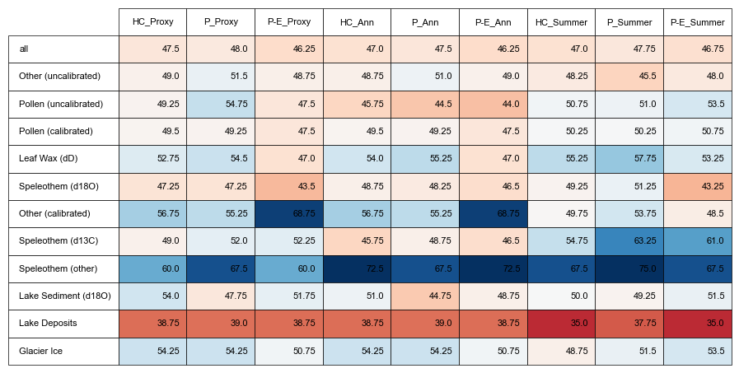

Slide 15
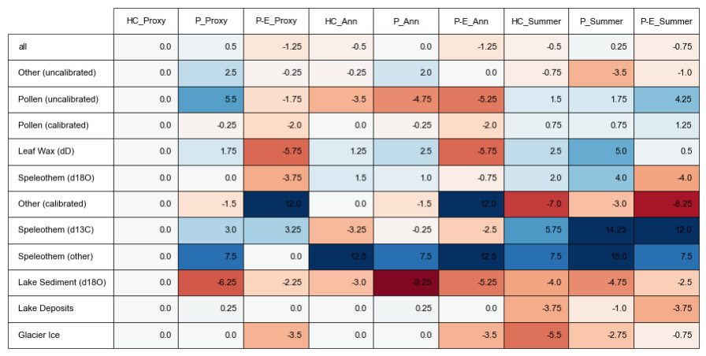

Slide 16
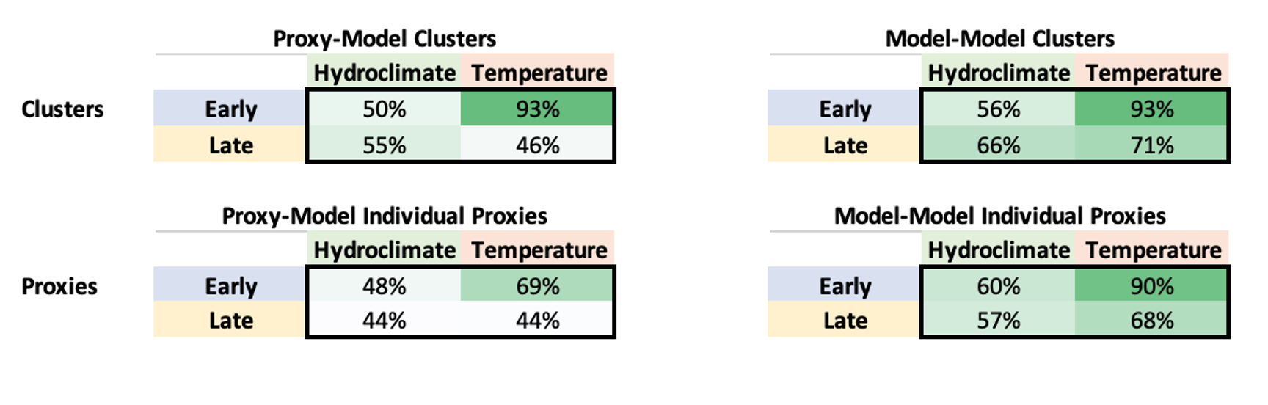

Slide 17
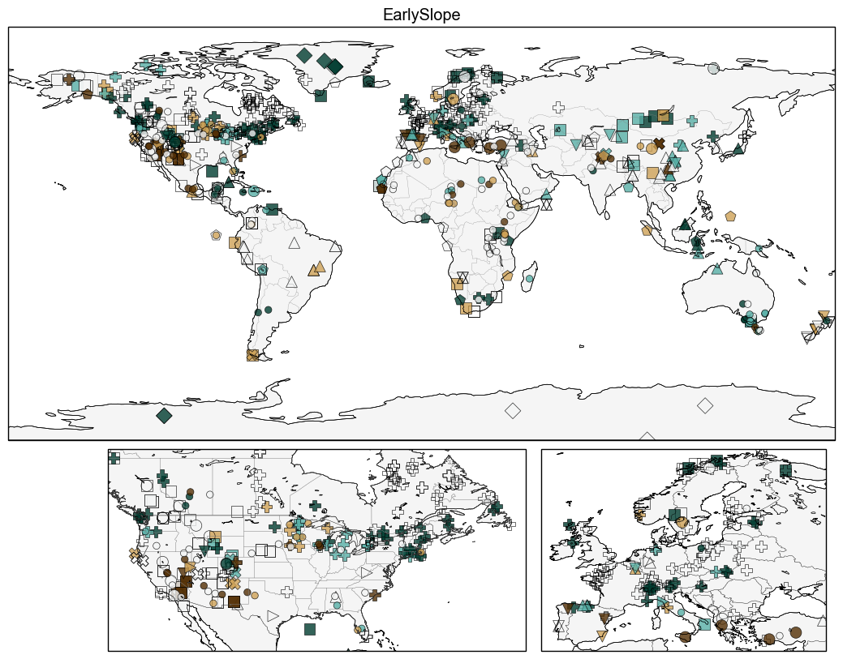
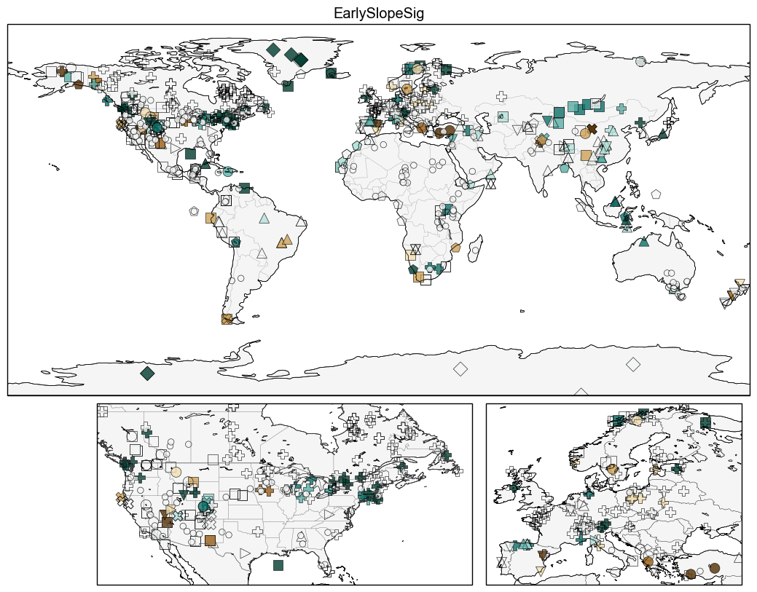

Slide 18
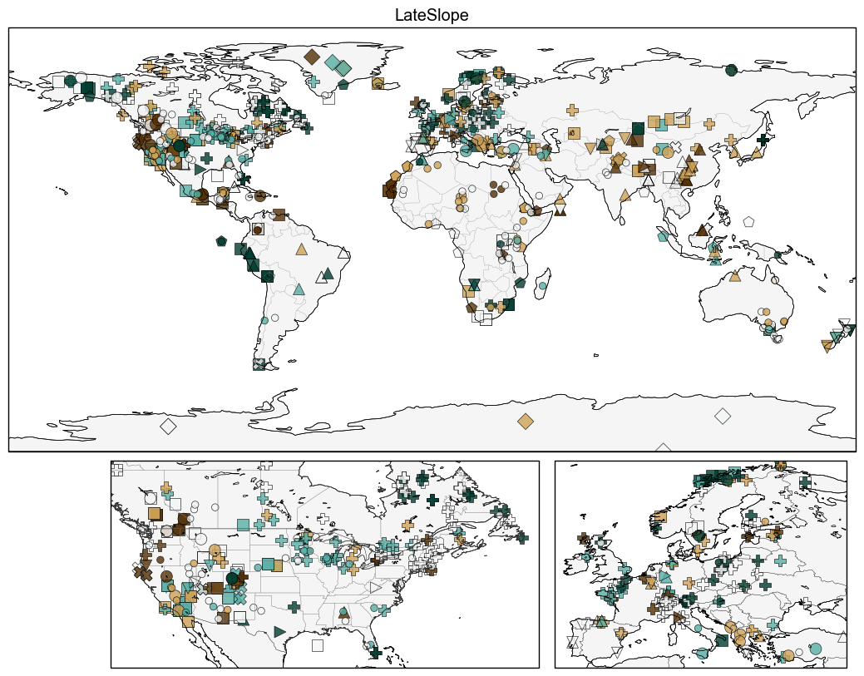
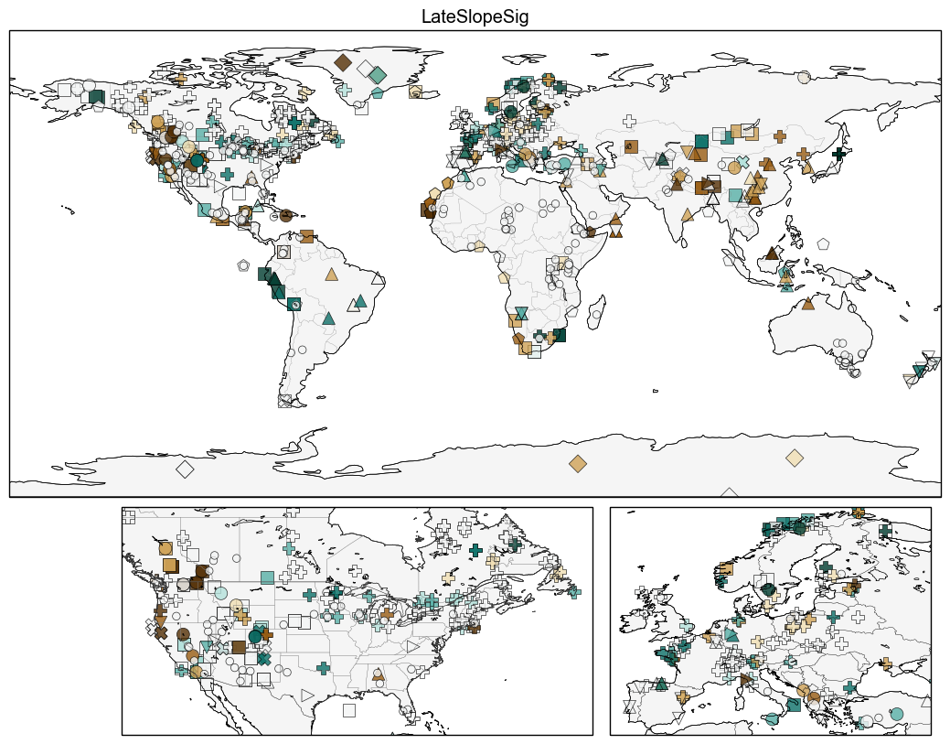

Slide 19
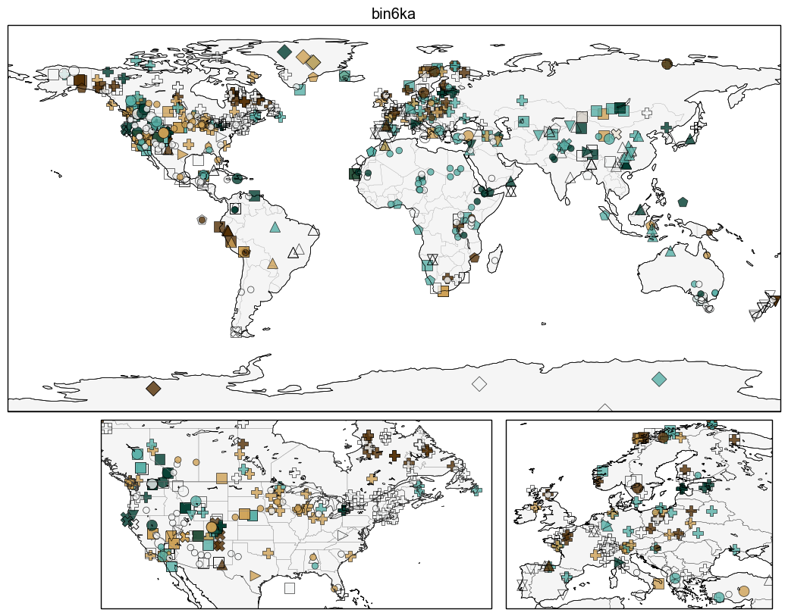

Slide 20
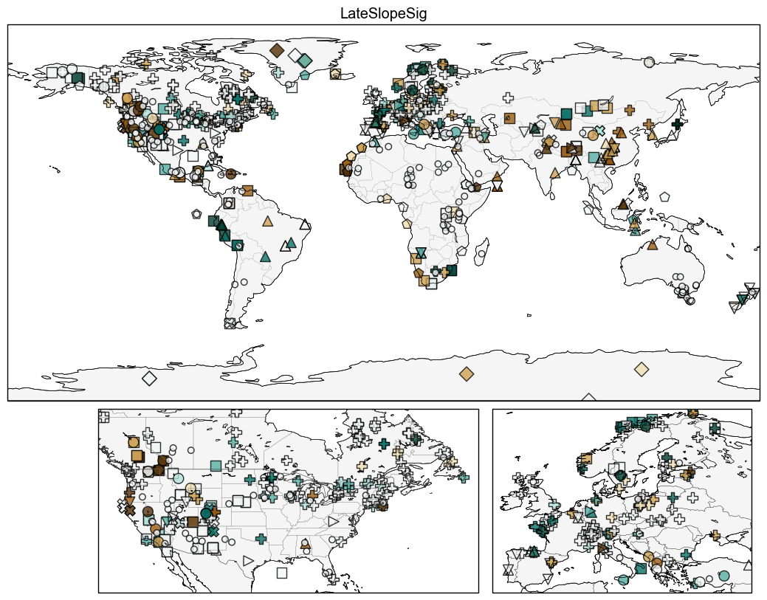

Slide 22
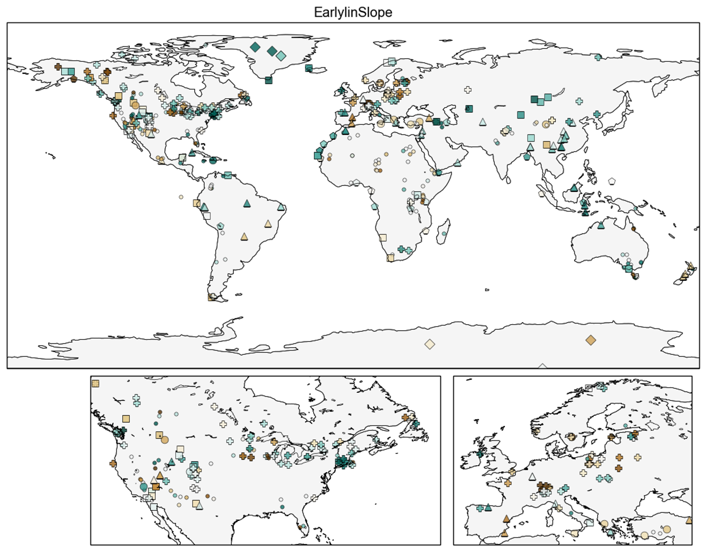

Slide 23
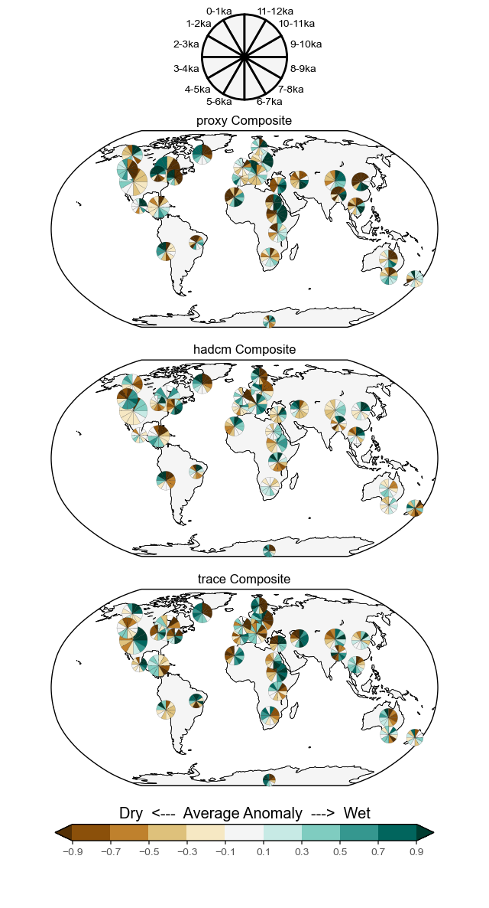
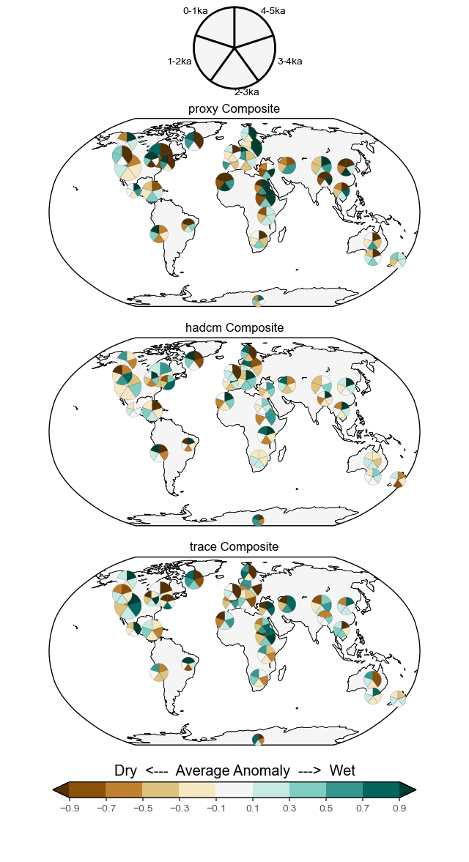

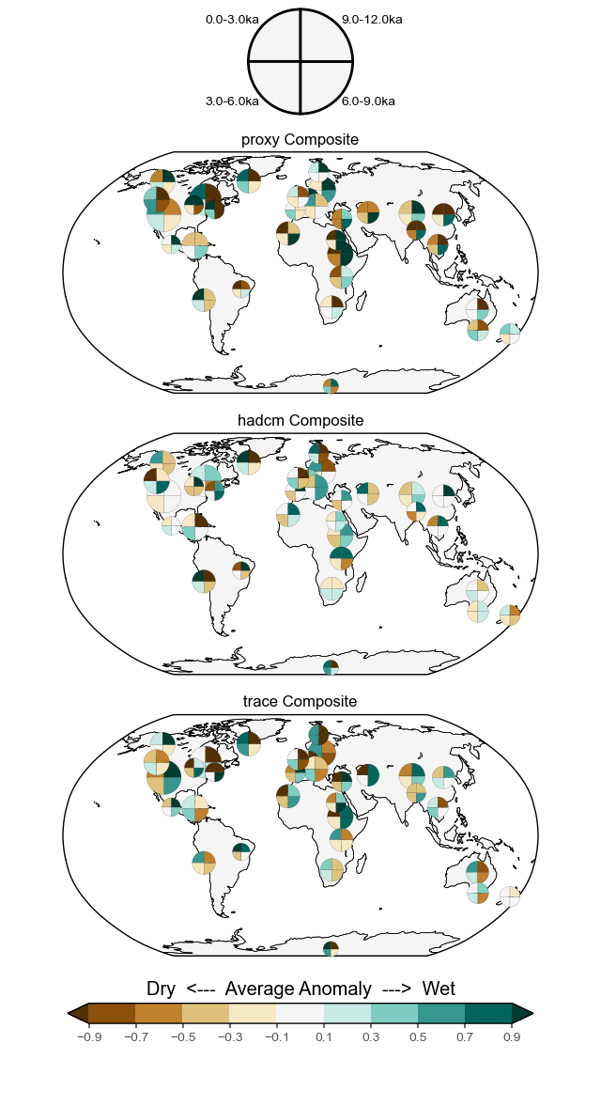

Notes:
Mean value for each timebin. Timeseries standardized over entire Holocene.

Slide 24
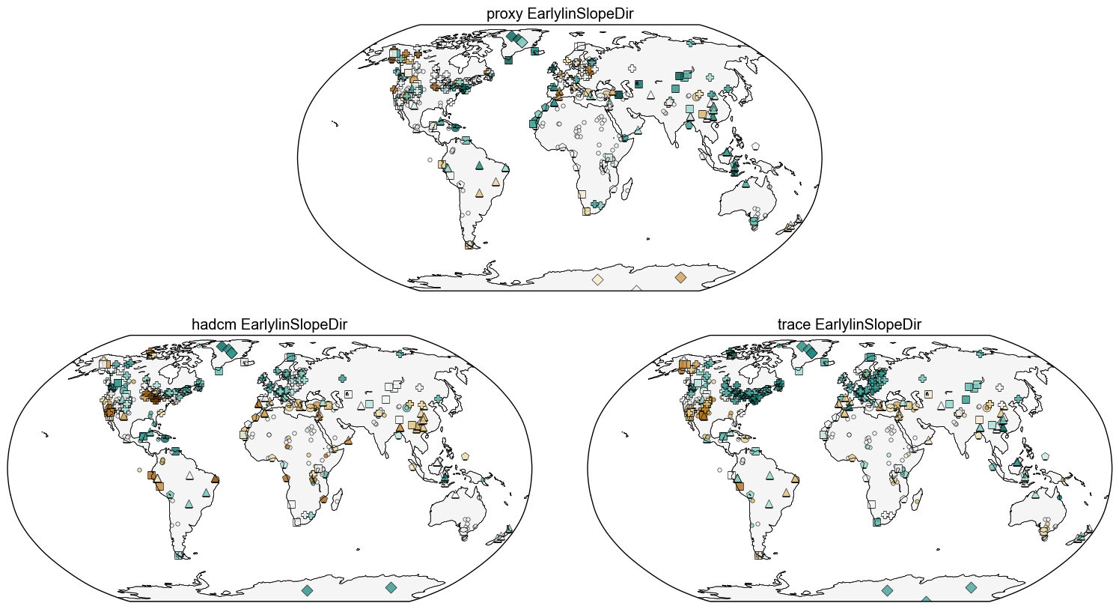

Slide 25
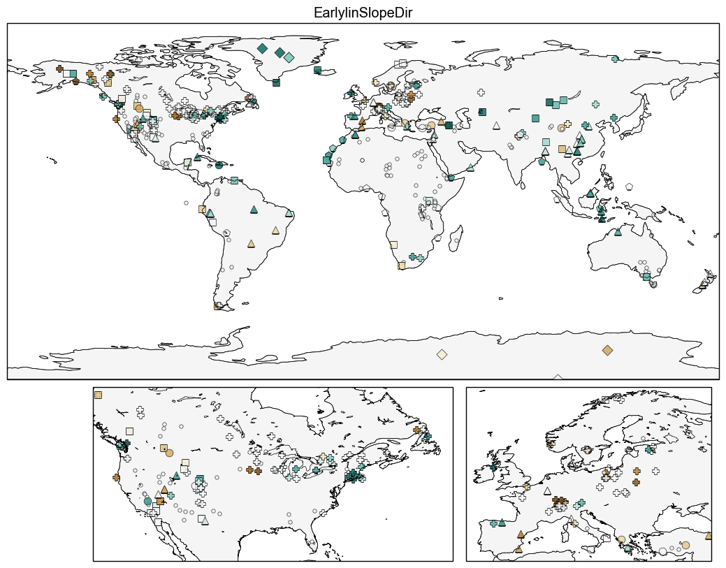

Slide 26
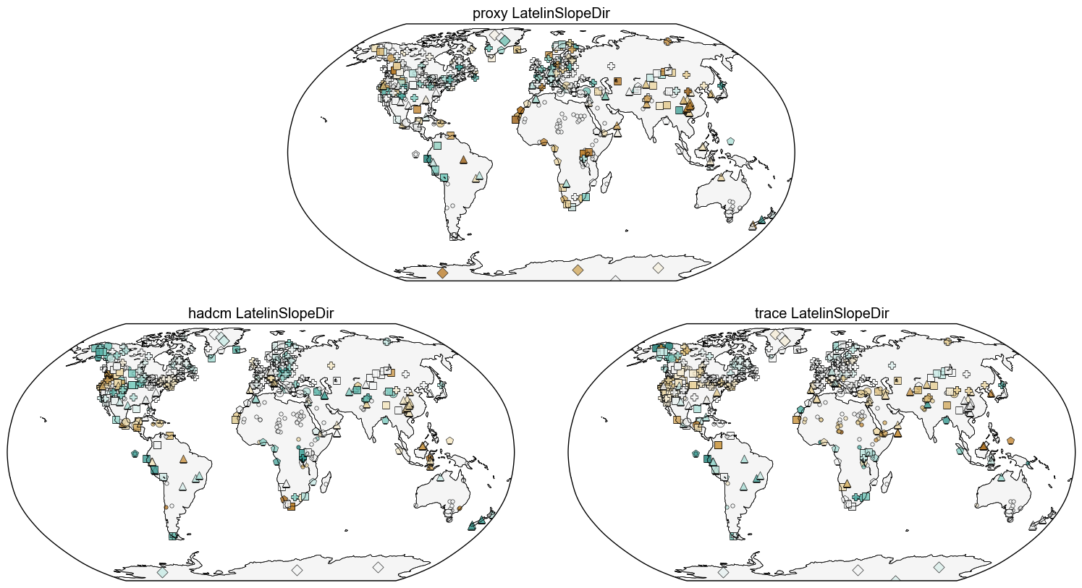

Slide 27
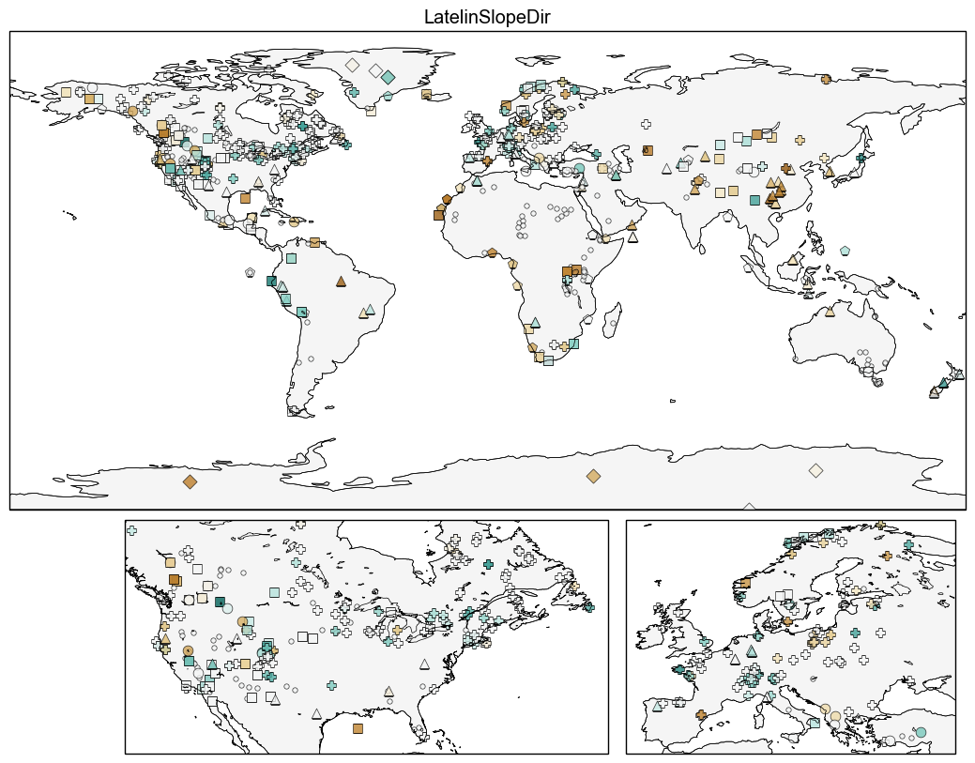

Slide 28
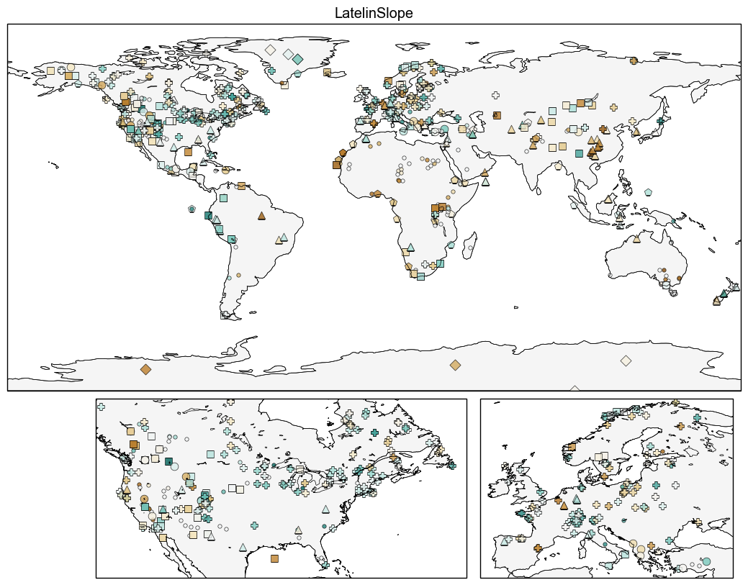

Slide 29
